Slide 1

Covid Vaccine Dashboard
V2.0
DATA 552 I PRESENTATION 2
Thomson Hawks | Eric Phillips | Mitch DeCock
March 22, 2021

Slide 2

Roadmap
1
Data to Dashboard
2
Architecture & Design
3
R-Challenges
4
Live Demo
5
Reflections & Questions

Slide 3


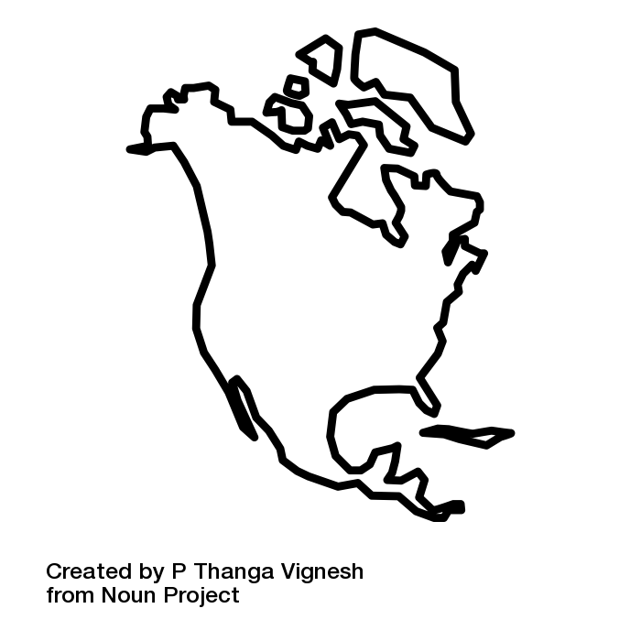


Data Flow
Our World
in Data
Process
Plot
Publish
GH Actions
COVID-19
Open Data
Working Group
+
Census
Notes:
Speak to methods

Slide 4

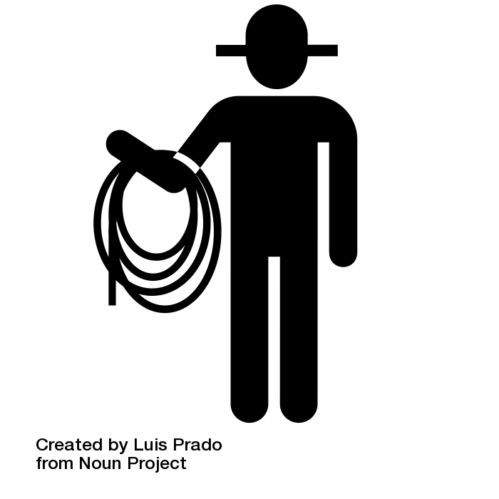
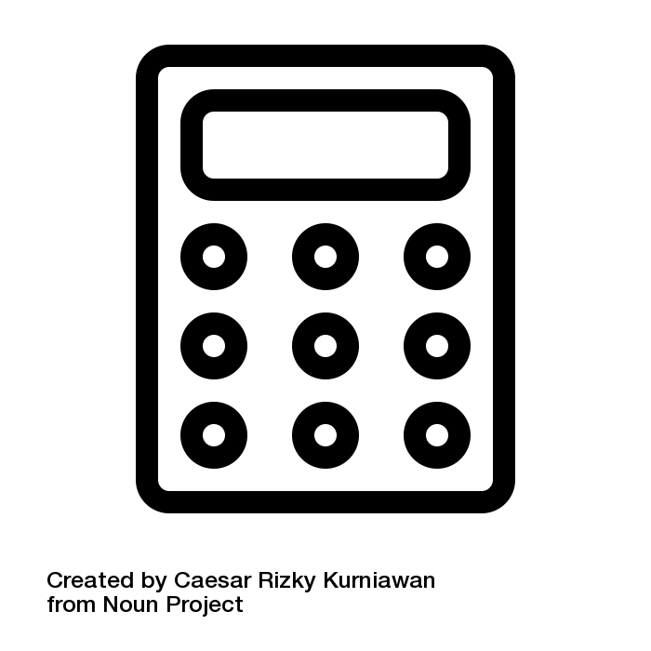
Process
Merge Pandas
Wrangle GeoPandas
Calculate Pandas
Notes:
Speak to methods

Slide 5
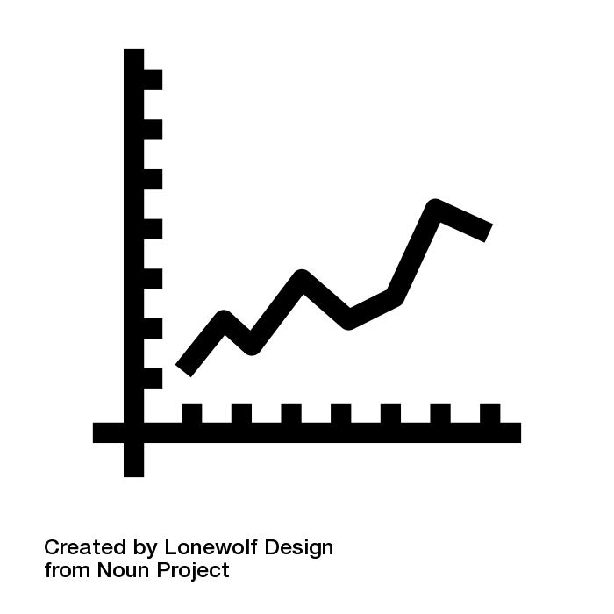


Plot & Publish
Altair Choropleth + Line
Dash Tabs + Selectors
Heroku GH + Deploy
Notes:
Speak to methods

Slide 6

Joan
Worries about her health and her family who live abroad.
More advanced users too!
Notes:
Provide company overview:
Consulting company.
Fostering the conscious use and development of technologies.
Creating more resilient companies and stronger communities.

Slide 7
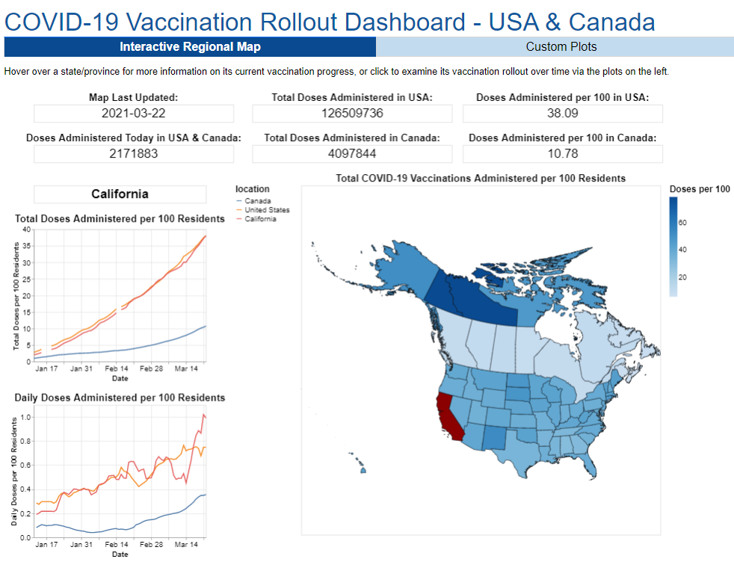
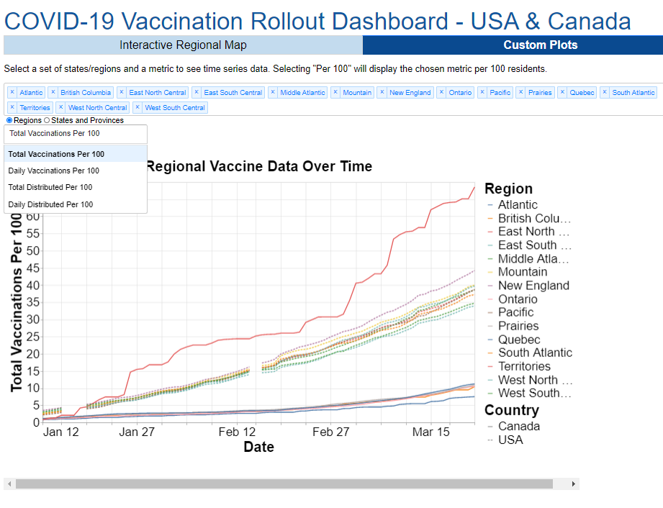

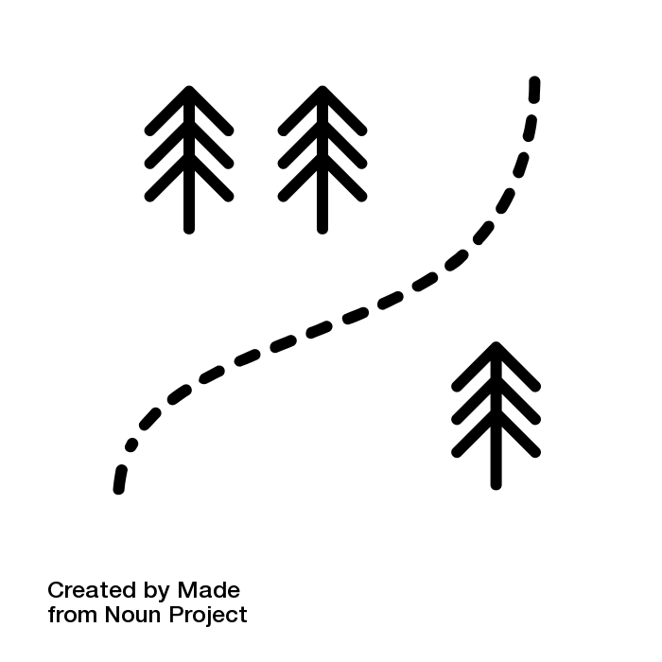

Use Cases + Tabs
Quick Check
Exploration
Deep Dive
Notes:
Provide company overview:
Consulting company.
Fostering the conscious use and development of technologies.
Creating more resilient companies and stronger communities.

Slide 8






User-Centered Design
Clear (Font + Color)
Relevant (GH Actions)
Engaging (Clickable)
Accessible (Heroku)
Exploratory (Tabs)
Inspiring (Open Source)

Slide 9

aRRRRRgh…
Altair Interactivity
Reticulate Wrangling
DashR Data Structures
Heroku Bilingual
R
Notes:
Provide company overview:
Consulting company.
Fostering the conscious use and development of technologies.
Creating more resilient companies and stronger communities.

Slide 10
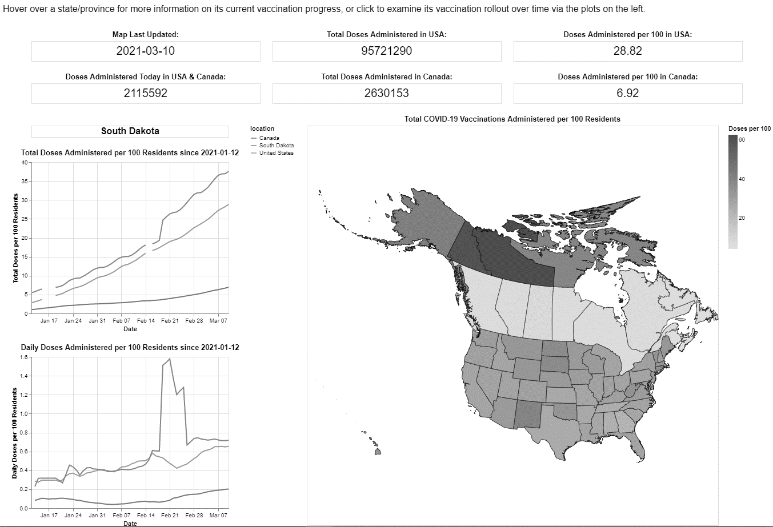
Live Demo
Notes:
Consulting

Slide 11
What next?
Notes:
Consulting

Slide 12


TO-DO
1
Date slider
2
Dynamic plot resizing
3
Fully vaccinated people
4
Covid cases integration

Slide 13
Questions?
Notes:
Consulting

Slide 14
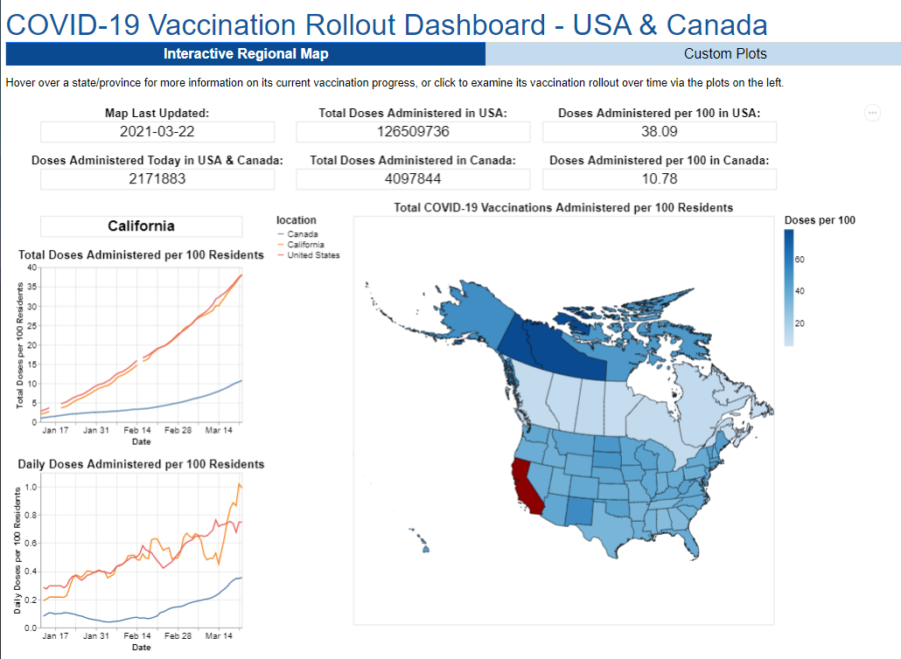
Notes:
Consulting

Slide 15
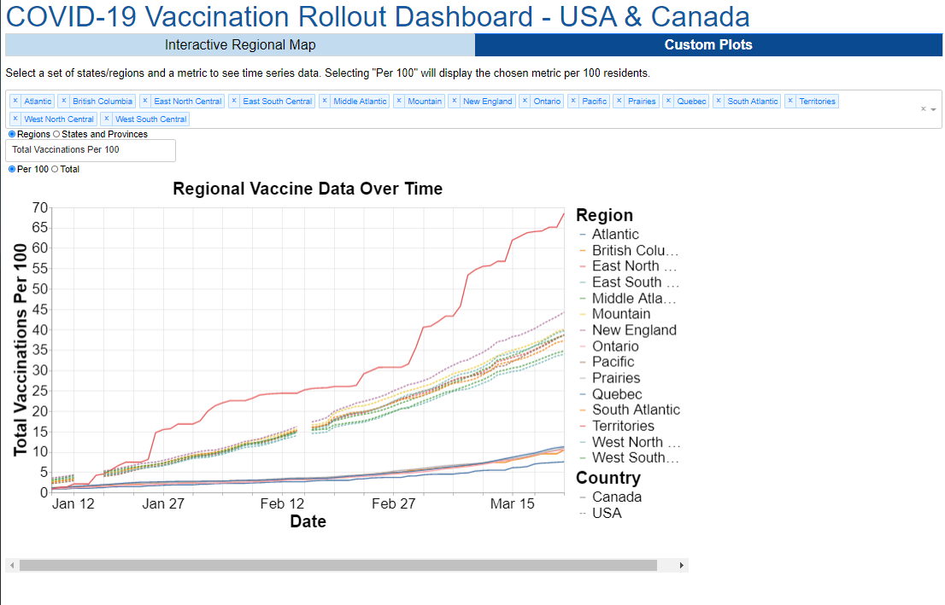
Notes:
Consulting

